Slide 1


Medical Insurance Project
Probability Course - Sekolah Data Pacmann
pacmann.io
© 2022 – Pacmann AI

Slide 2
Outline
Introduction
Dataset
Descriptive Statistic Analysis
Categorical Variables Analysis
Continuous Variables Analysis
Variables Correlation
Hypothesis Testing
Conclusion

Slide 3
Introduction
Notes:
Transisi antar outline

Slide 4
Introduction
Analyze relations between variables (e.g. age, sex) and health bill received by each user.
Implementation of studies on probability and hypothesis testing using actual data.

Slide 5
Dataset
Notes:
Transisi antar outline

Slide 6
Dataset
This project used personal health bill data from the United States which has seven variables with variable costs showing the charge of health bills.
Variables | Description
age | Age of primary beneficiary
sex | Insurance contractor gender, female, male
BMI | Body mass index, providing an understanding of body, weights that are relatively high or low relative to height, objective index of body weight (kg/m2) using the ratio of height to weight, ideally 18.5 to 24.9
children | Number of children covered by health insurance / Number of dependents
smoker | Smoking
region | The beneficiary's residential area in the US, northeast, southeast, southwest, northwest
charges | Individual medical costs billed by health insurance

Slide 7
Descriptive Statistics Analysis
Notes:
Transisi antar outline

Slide 8
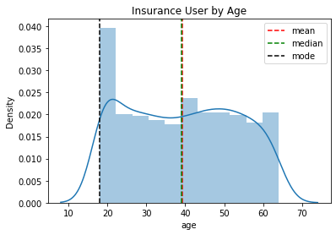
Mean of Age
Analyze average of age user using density plot.
Based on the picture below we could see that we can use mean or median data as average of insurance user by age because the data is evenly distributed.
The average of insurance user is 39.

Slide 9
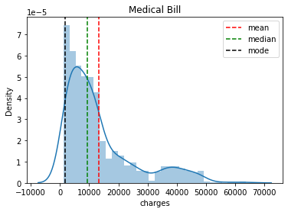
Mean of Charges
Analyze average of charges using density plot.
Based on the picture below we could see that charges data is positively skewed so we use median for average of charges.
The average of charges is 9382.033.

Slide 10
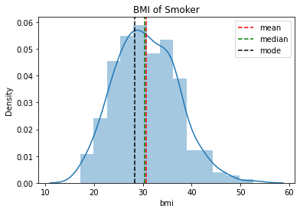
Mean of Smoker BMI
Analyze average of smoker BMI using density plot.
Based on the picture below we could see that we can use mean or median data as average of smoker BMI because the data is evenly distributed.
The average of smoker BMI is 30.45.

Slide 11
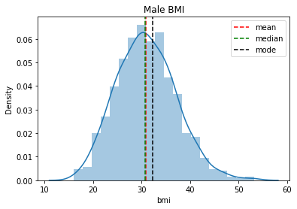
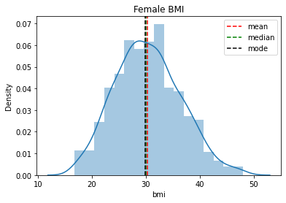
Average BMI by Sex
Analyze average of BMI by sex using density plot.
Based on the picture below we could see that average of male BMI is slightly bigger than female BMI.

Slide 12
Analysis
Medical insurance dataset contains 7 variables and 1338 rows of data. For descriptive statistics analysis, we can conclude that users of this medical insurance are below 20 years old until above 60 years old and the average user are 39 years old.
The average charges are around 9382 dollars. Even though most charges are below 5.000 dollars, some user pay charges until 50.000 dollars.
Male BMI is slightly bigger than female BMI but similar to smoker BMI. The average BMI are 30 means that the average user is obese.

Slide 13
Categorical Variables Analysis
Notes:
Transisi antar outline

Slide 14
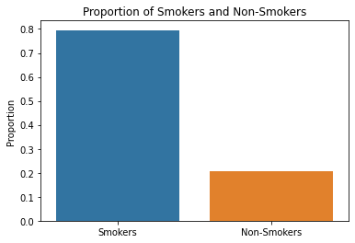
Proportion of smokers and non-smokers
Analyze the proportion of smokers and non-smokers using data frame group by function divided by length data.
Based on the picture below, the proportion of smokers is higher than the proportion of non-smokers.

Slide 15
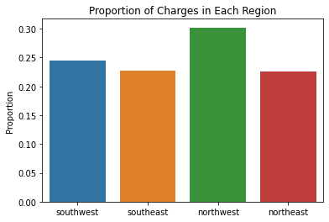
Proportion of charges in each region
Analyze the proportion charges of each region using data frame group by function divided by total charges for all regions.
Based on the picture below, the top proportion of charges is in the northwest region. Followed by southwest in second place, and southeast and northeast in the last place with the same proportion.

Slide 16
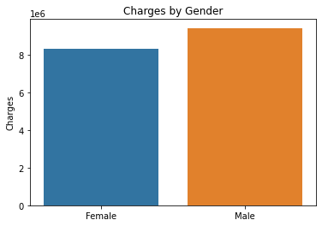
Sex with the most charges in insurance bill
Analyze the charges by sex using data frame group by function.
Based on the picture below, the male has more charges in insurance bill than the female.

Slide 17
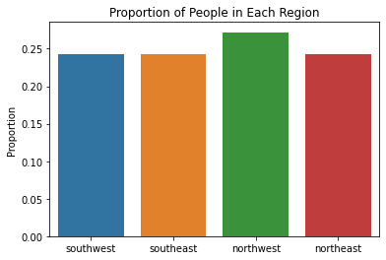
Proportion of people in each region
Analyze the proportion charges of each region using data frame group by function divided by total charges for all regions.
Based on the picture below, the northwest region has the most proportion of people followed by the southwest, southeast, and northeast with the same proportion of people.

Slide 18
Analysis
For categorical variables analysis, the proportion of smokers is four times bigger than the proportion of non-smokers.
The northwest region has the most proportion of people and charges compared to other regions.
If we group charges by gender, the male has more charges in the insurance bill than the female.

Slide 19
Continuous Variables Analysis
Notes:
Transisi antar outline

Slide 20
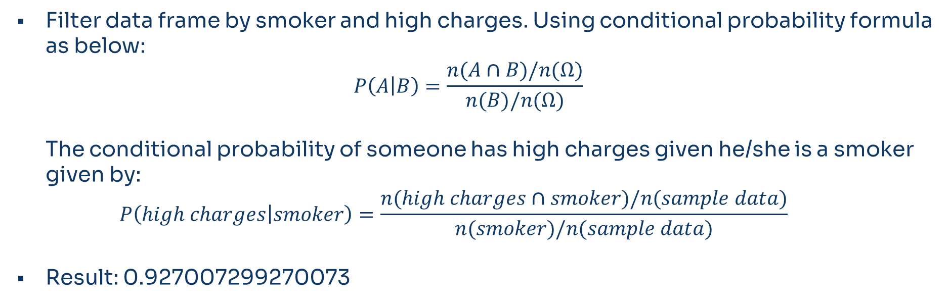
Probability of someone has high charges given he’s a smoker
Filter data frame by smoker and high charges. Using conditional probability formula as below:
$$P\left(A | B\right)=\frac{n(A∩B)/n(Ω)}{n(B)/n(Ω)}$$
The conditional probability of someone has high charges given he/she is a smoker given by:
$$P\left(high charges | smoker\right)=\frac{n(high charges∩smoker)/n(sample data)}{n(smoker)/n(sample data)}$$
Result: 0.927007299270073

Slide 21
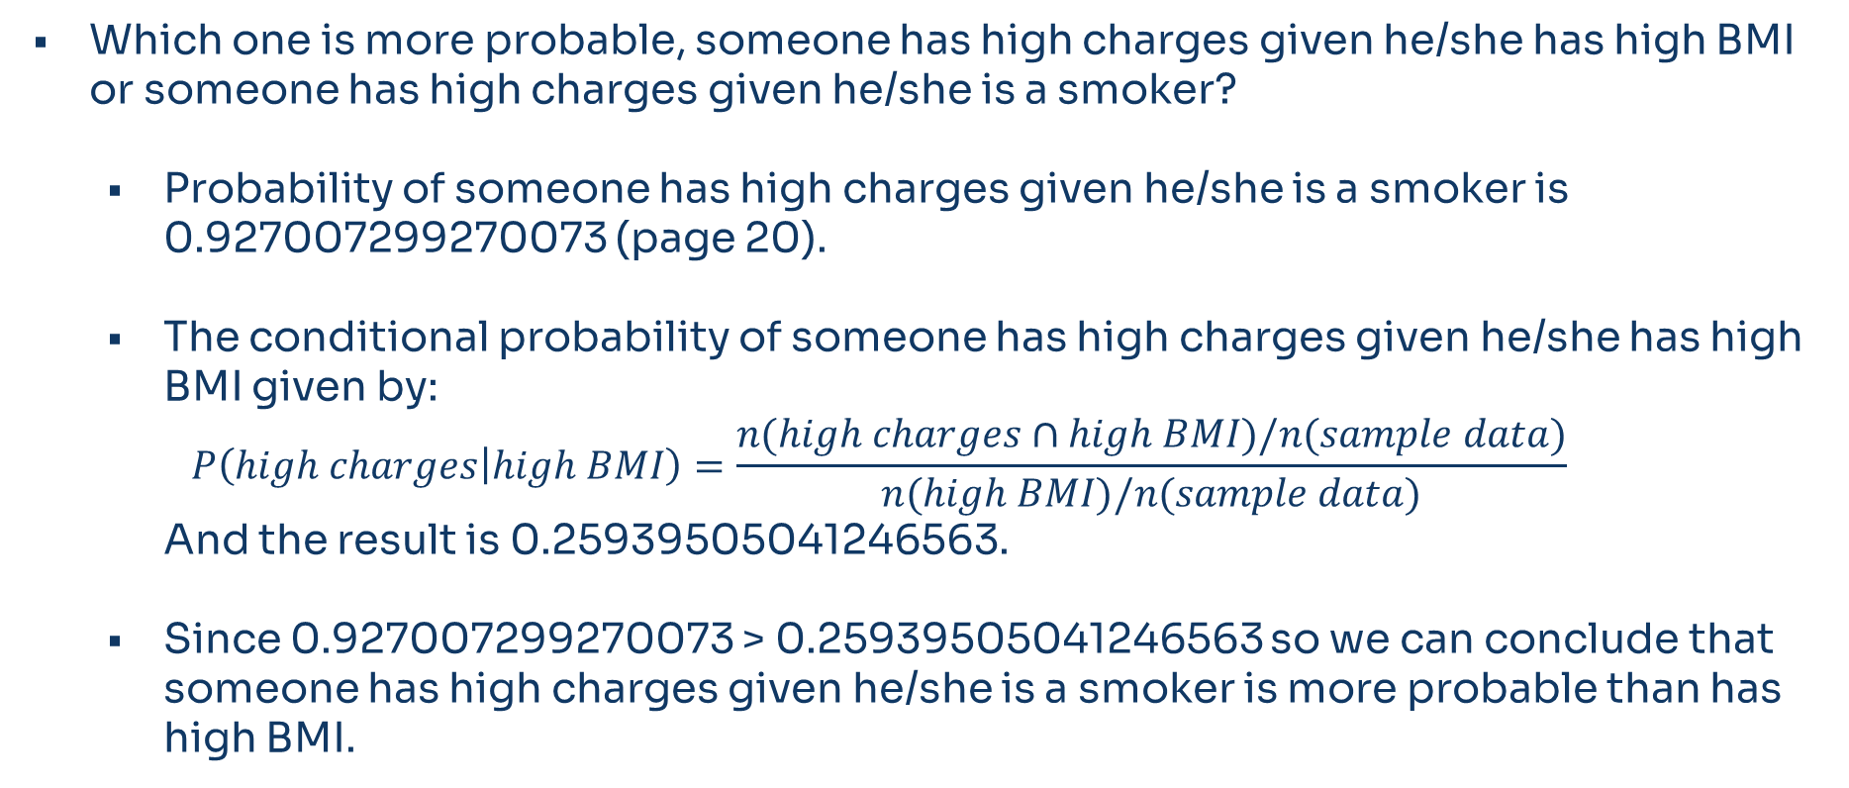
BMI vs Smokers
Which one is more probable, someone has high charges given he/she has high BMI or someone has high charges given he/she is a smoker?
Probability of someone has high charges given he/she is a smoker is 0.927007299270073 (page 20).
The conditional probability of someone has high charges given he/she has high BMI given by:
$$P\left(high charges | high BMI\right)=\frac{n(high charges∩high BMI)/n(sample data)}{n(high BMI)/n(sample data)}$$
And the result is 0.25939505041246563.
Since 0.927007299270073 > 0.25939505041246563 so we can conclude that someone has high charges given he/she is a smoker is more probable than has high BMI.

Slide 22
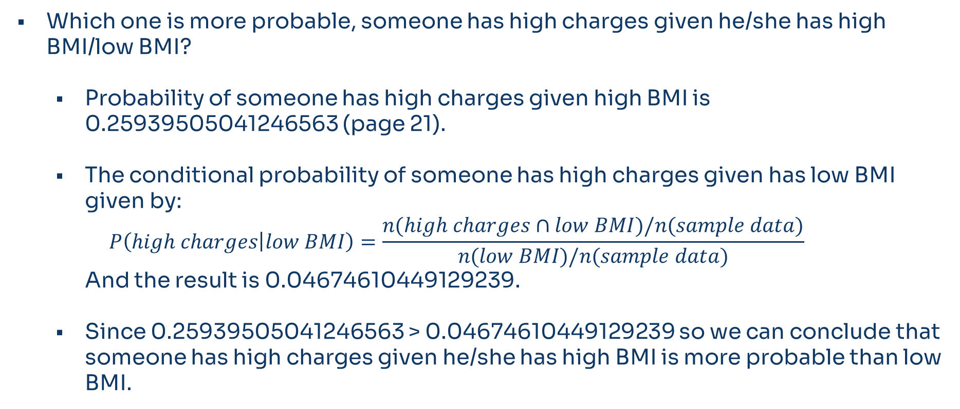
High BMI vs Low BMI
Which one is more probable, someone has high charges given he/she has high BMI/low BMI?
Probability of someone has high charges given high BMI is 0.25939505041246563 (page 21).
The conditional probability of someone has high charges given has low BMI given by:
$$P\left(high charges | low BMI\right)=\frac{n(high charges∩low BMI)/n(sample data)}{n(low BMI)/n(sample data)}$$
And the result is 0.04674610449129239.
Since 0.25939505041246563 > 0.04674610449129239 so we can conclude that someone has high charges given he/she has high BMI is more probable than low BMI.

Slide 23
Smokers with high BMI vs Non-Smokers with high BMI
Which one is more probable, someone has high charges given she/he has high BMI and a smoker or non smoker?
Using conditional probability so we filter the data frame by high charges and high BMI and group by smoker
The probability for non-smokers is 0.0779816513761468 and for smokers is 0.9817351598173516, so we can conclude that someone probably has high charges given by has high BMI and a smoker than a non smoker.

Slide 24
Analysis
For continuous variables analysis, the proportion of someone has high charges given she/he has high BMI is bigger than given she/he has low BMI.
And the probability someone has high charges given she/he is a smokers is four times bigger than she/he has high BMI.
But the highest probability for high charges is given by smokers with high BMI.

Slide 25
Variables Correlation
Notes:
Transisi antar outline

Slide 26
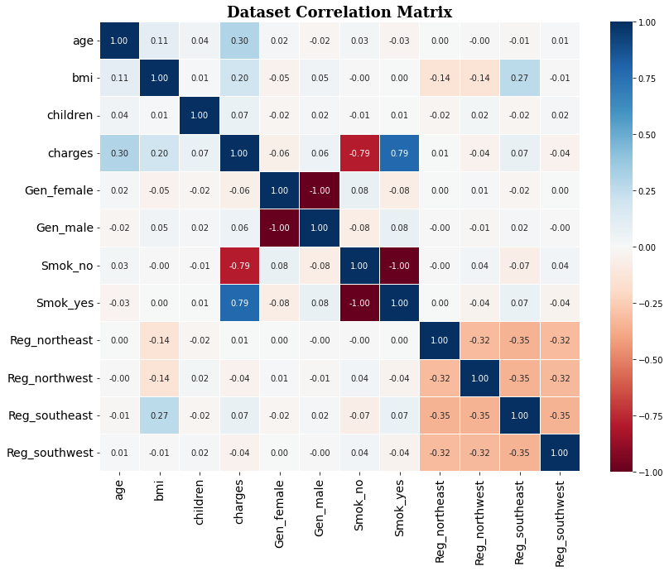
Correlation
Analyze variables correlation using the heatmap plot. Based on the picture we could see that charges have a positive correlation with smokers, which means the charges will improve if the person chooses to become a smoker.
The charges also have a negative correlation with non-smokers, which means if the person is a non-smoker, the charges insurance bill will reduce.

Slide 27
Hypothesis Testing
Notes:
Transisi antar outline

Slide 28
Smoker’s charges are higher than non smoker’s
Skewness and kurtosis tests to check smoker and non-smoker distribution if it is a normal distribution or not. Because the result is positively skewed and leptokurtic, the data need to transform the distribution to normal distribution using box cox transformation.
The p-value calculated using the Shapiro-Wilks test and the statistic calculated using Anderson-Darling test indicates a significant departure from normality. However, since the sample sizes of both sets of data are greater than 30 (n > 30) testing whether the two populations have the same variances using Levene’s test.
Since two populations don't have the same variances, the p-value calculate using Welch's two-sample.
Results:
P-value is 0.00.
Since the p-value is less than the alpha value, reject the Null Hypothesis: claims by smokers are greater than claims by non-smokers.

Slide 29
User with BMI above 25 charges are higher than below 25
Skewness and kurtosis tests to check BMI above 25 and BMI below 25 distribution if it is a normal distribution or not. Because the result is positively skewed and leptokurtic, the data need to transform the distribution to normal distribution using box cox transformation.
The p-value calculated using the Shapiro-Wilks test and the statistic calculated using Anderson-Darling test indicates a significant departure from normality. However, since the sample sizes of both sets of data are greater than 30 (n > 30) testing whether the two populations have the same variances using Levene’s test.
Since two populations don't have the same variances, the p-value calculate using Welch's two-sample.
Results:
P-value is 0.00.
Since the p-value is less than the alpha value, reject the Null Hypothesis: claims by user with BMI above 25 are greater than claims by user with BMI below 25.

Slide 30
Male has the same BMI as female
Skewness and kurtosis tests to check BMI above 25 and BMI below 25 distribution if it is a normal distribution or not.
The p-value calculated using the Shapiro-Wilks test and the statistic calculated using Anderson-Darling test indicates the distribution are approximately normal.
Testing variances using Bartlett’s test.
Hypothesis test using Student's Two-Sample t-test.
Results:
P-value is 0.00004078.
Since the p-value is less than the alpha value, fail to reject the Null Hypothesis: male has the same BMI as female.

Slide 31
Conclusion
Notes:
Transisi antar outline

Slide 32
Conclusion
The user of this insurance may vary from below 20 years old to above 60 years old. The average BMI is 30, which is high because BMI is ideally 18.5 to 24.9.
If we group charges by gender, the male has more charges in the insurance bill than the female. But the highest probability for high charges is given by smokers with high BMI.

Slide 33
Notes
Need to learn more about probability and hypothesis testing with examples using python
Check for the analysis and visualization before upload project to github or other url.

Slide 34
Reference
https://www.kaggle.com/code/jordanrich/hypothesis-testing-of-health-insurance-data/notebook#Hypothesis-Testing
https://accounting.binus.ac.id/2021/08/12/memahami-nilai-kurtosis-keruncingan-dalam-statistik-deskriptif/#:~:text=Nilai%20excess%20kurtosis%20menunjukkan%20data,0.142%20dan%20KP5%20adalah%201.099
https://statistics.laerd.com/statistical-guides/measures-central-tendency-mean-mode-median.php
https://colab.research.google.com/drive/1zwSooWJc1sNvvQU2CBwjz4q0-ihtJ0We?hl=id#scrollTo=hUhAZAcvFxnv

